Slide 1


Intermediate Python
Advanced Class Topics

Slide 2
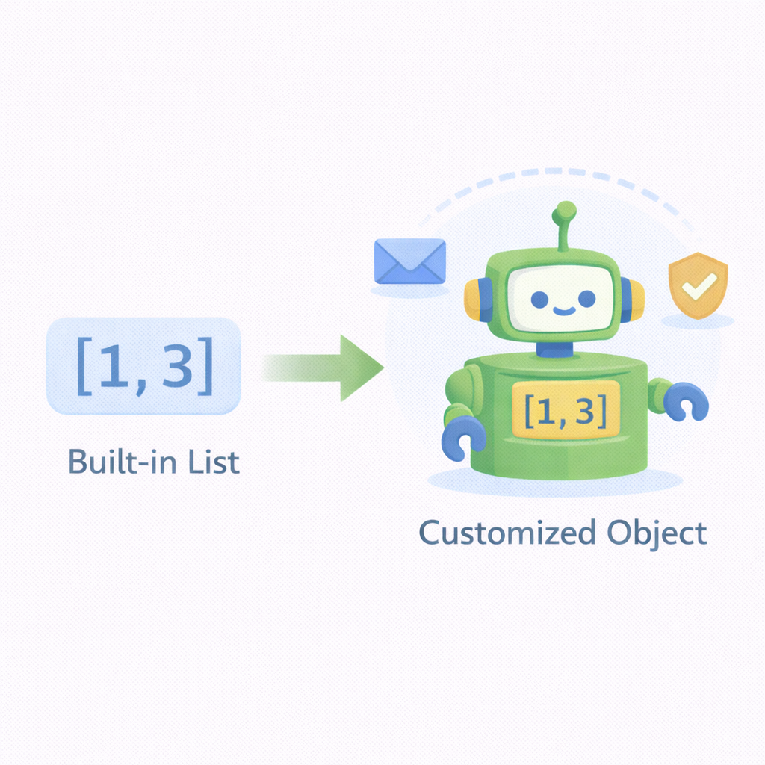
Extending Built-in Types
Python allows you to extend built-in types to add domain-specific behavior.
Inherit from built-ins like list, dict, str
Add custom methods or override behavior
Retain all original functionality
Useful for validation and domain rules
Must respect original type semantics
Notes:
Explain that inheritance here is safe because the new class is still a list. Warn about over-overriding built-in behavior.

Slide 3
Source Code Example
class ScoreList(list):
def average(self):
return sum(self) / len(self) if self else 0

Slide 4
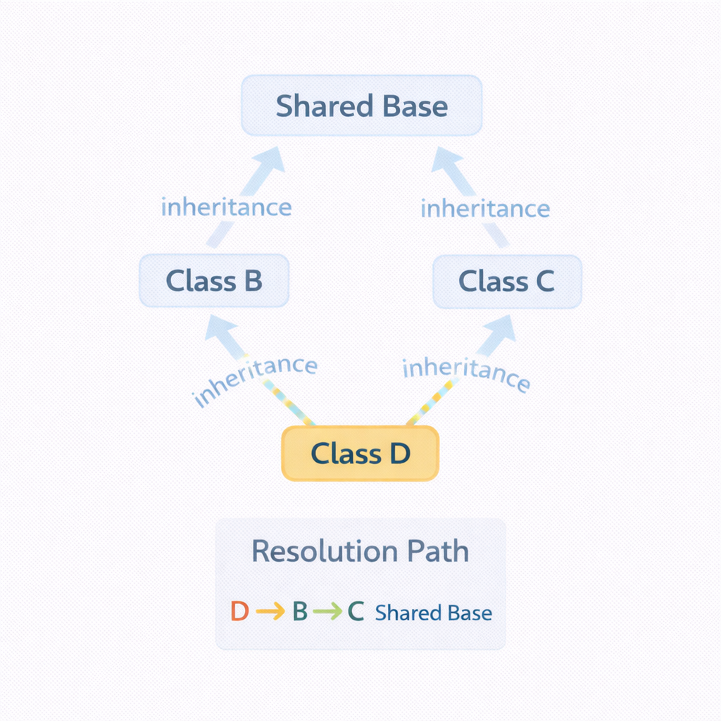
Method Resolution Order (MRO)
MRO defines the order Python follows to find methods in inheritance chains.
Python uses C3 linearization
Determines which method is called first
Critical in multiple inheritance
Accessible via Class.__mro__
Prevents ambiguity in diamond inheritance
Notes:
Stress that Python resolves conflicts deterministically. Understanding MRO prevents subtle bugs.

Slide 5
Source Code Example
class A: pass
class B(A): pass
class C(A): pass
class D(B, C): pass
print(D.__mro__)

Slide 6
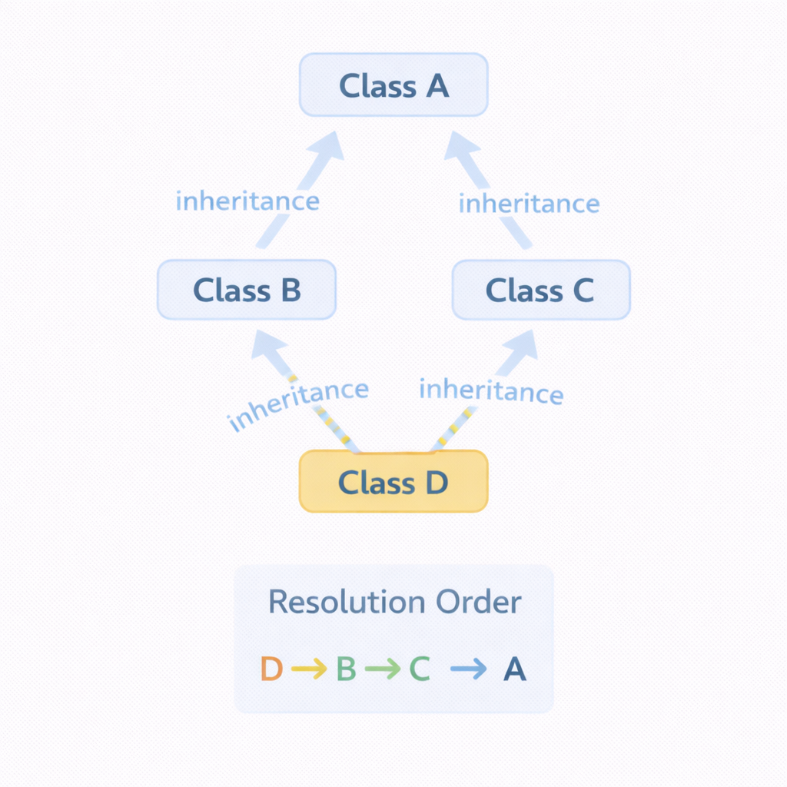
Diamond Inheritance Pattern
Diamond inheritance occurs when a class inherits from two classes sharing a common base.
Can cause method ambiguity
MRO ensures each class appears once
super() follows MRO order
Poor design can confuse behavior
Often replaced by composition
Notes:
Use this to motivate composition over deep inheritance. Explain why super() must be used consistently.

Slide 7
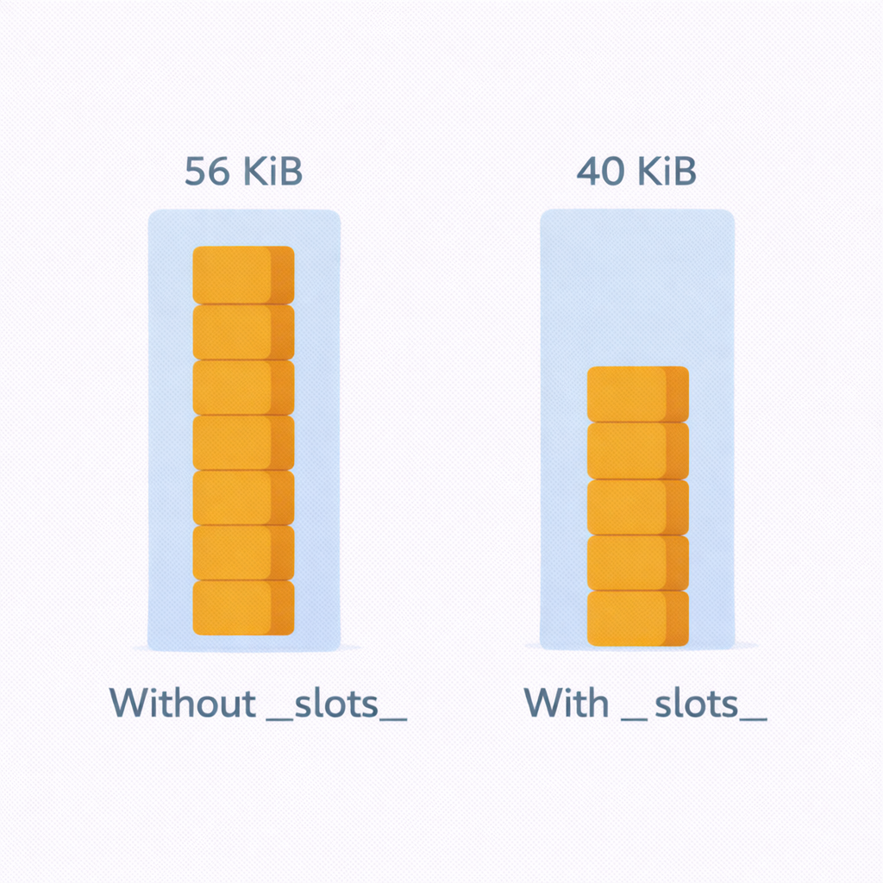
Memory Optimization with __slots__
__slots__ restricts attribute creation and reduces memory usage.
Prevents dynamic attribute creation
Reduces per-instance memory
Improves performance for many objects
Disables __dict__
Best for data-heavy classes
Notes:
Mention this is an optimization, not a default choice. Common in performance-critical systems.

Slide 8
Source Code Example
class Point:
__slots__ = ("x", "y")
def __init__(self, x, y):
self.x = x
self.y = y

Slide 9
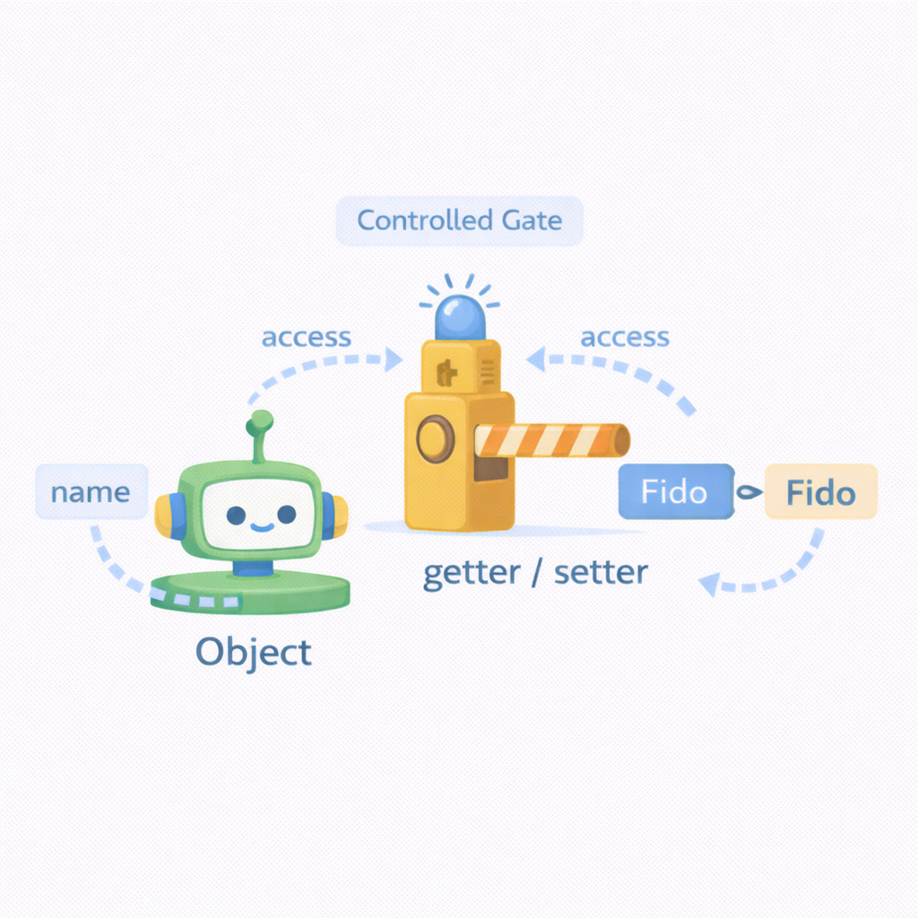
Properties (@property)
Properties provide controlled access to attributes using method syntax.
Access methods like attributes
Enables validation and computation
Hides internal representation
Improves API clarity
Supports getters and setters
Notes:
Emphasize that properties preserve backward compatibility. Avoid exposing raw attributes prematurely.

Slide 10
Source Code Example
class Person:
def __init__(self, age):
self._age = age
@property
def age(self):
return self._age
@age.setter
def age(self, value):
if value < 0:
raise ValueError("Age must be positive")
self._age = value

Slide 11
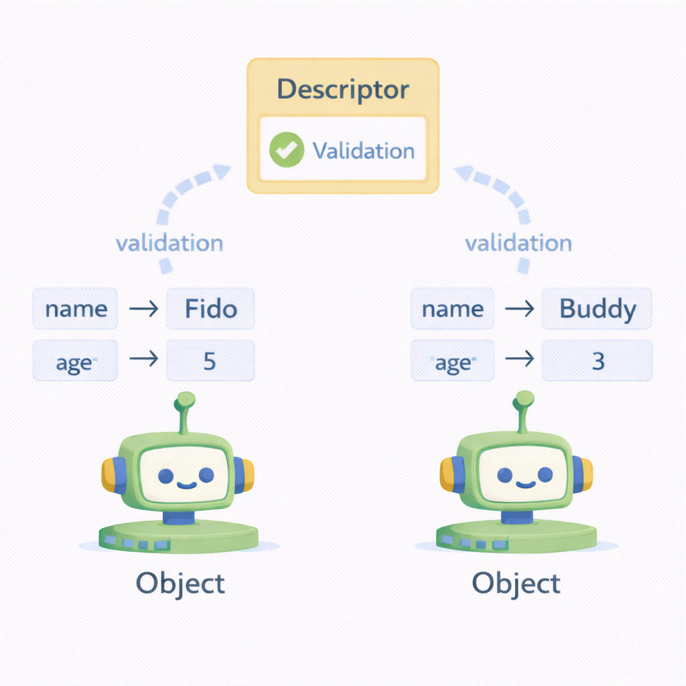
Descriptors: The Generalized Property
Descriptors define reusable attribute behavior across classes.
Implement __get__, __set__, __delete__
Used internally by properties
Enable shared validation logic
More powerful than properties
Common in frameworks and ORMs
Notes:
Explain this is an advanced topic. Mention Django ORM fields as real-world usage.

Slide 12
Source Code Example
class Positive:
def __set__(self, instance, value):
if value <= 0:
raise ValueError("Must be positive")
instance.__dict__[self.name] = value
def __set_name__(self, owner, name):
self.name = name

Slide 13
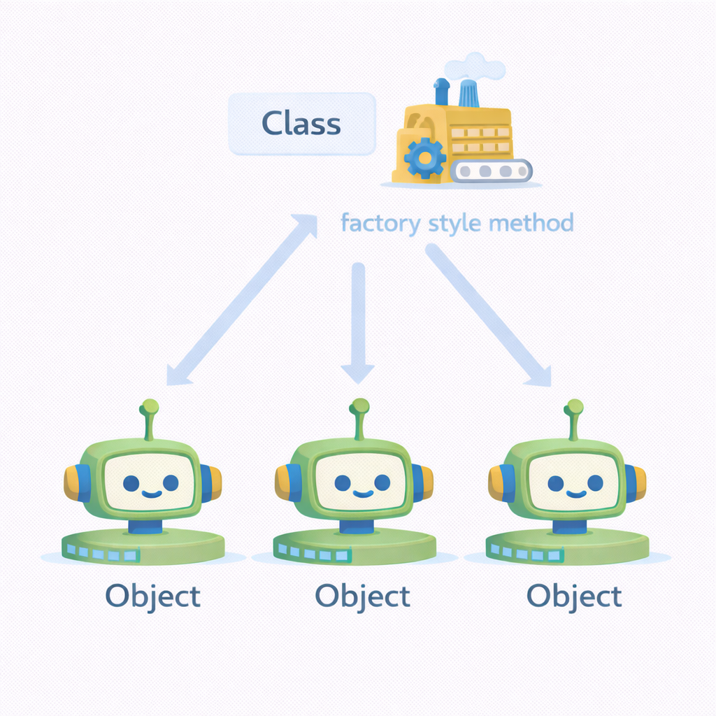
Static Methods
Static methods belong to a class but don’t access instance or class state.
Defined using @staticmethod
No self or cls
Utility or helper logic
Namespaced under the class
Improves organization
Notes:
Clarify when a function should be static vs free function. Static methods group related logic.

Slide 14
Source Code Example
class MathUtils:
@staticmethod
def is_even(n):
return n % 2 == 0

Slide 15
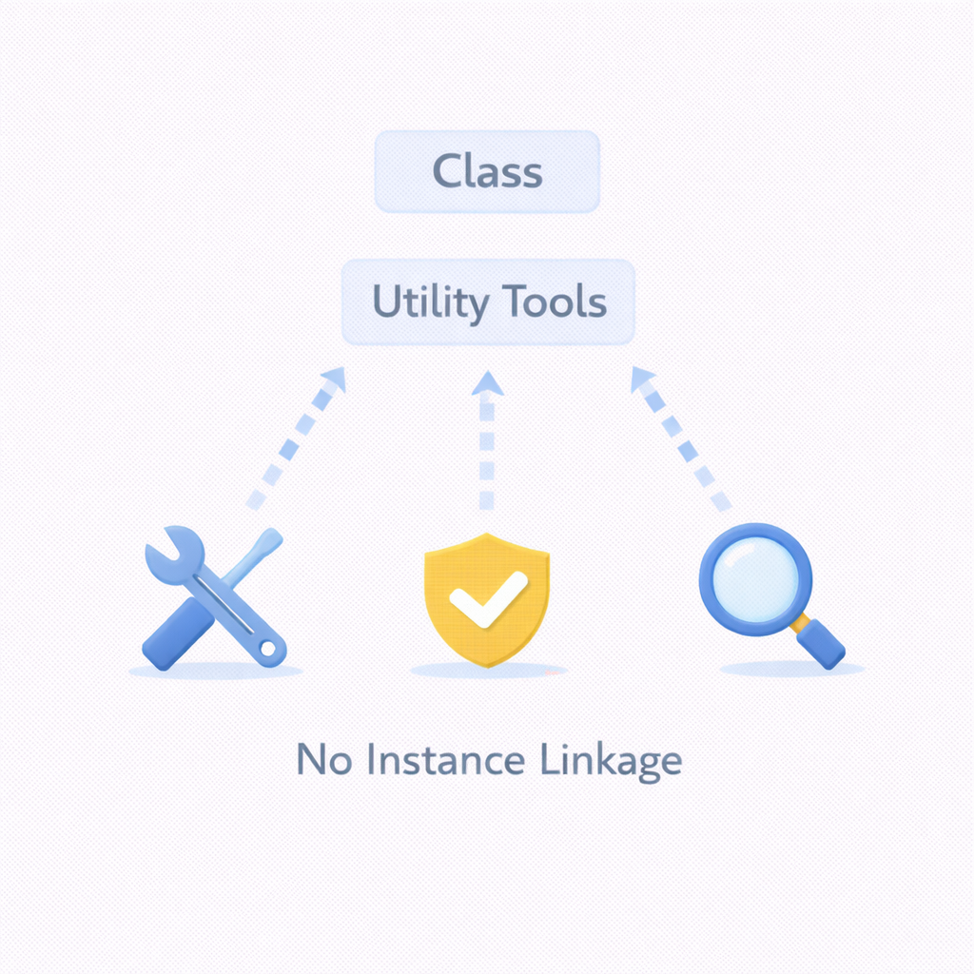
Class Methods
Class methods operate on the class itself rather than instances.
Defined using @classmethod
Receive cls instead of self
Common for factories
Can modify class-level state
Respects inheritance
Notes:
Explain how factories simplify object creation. Contrast with static methods.

Slide 16
Source Code Example
class User:
def __init__(self, name):
self.name = name
@classmethod
def guest(cls):
return cls("Guest")

Slide 17
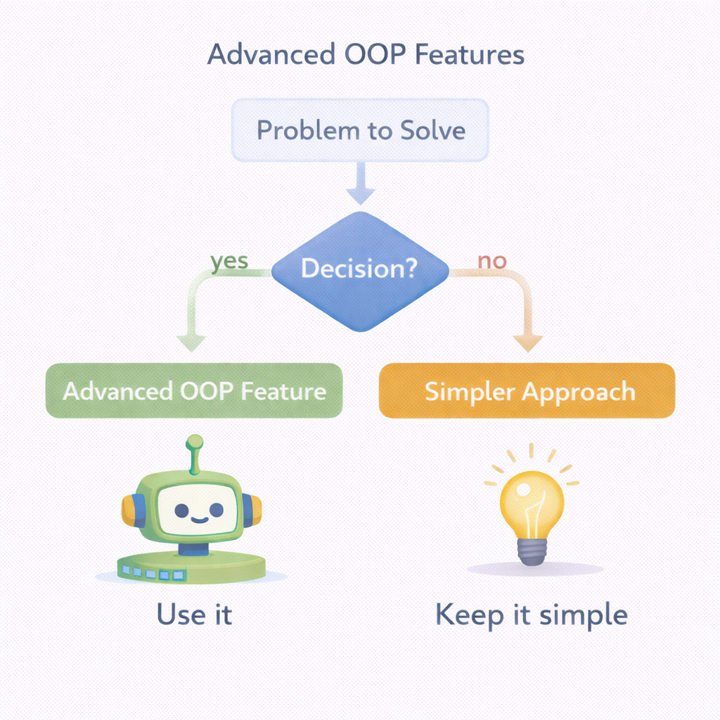
Choosing the Right Tool
Advanced class features should be used deliberately, not automatically.
Prefer simplicity first
Use inheritance only for true “is-a”
Use properties for controlled access
Use descriptors for shared rules
Optimize with __slots__ when needed
Notes:
Encourage thoughtful design, not feature-heavy code. Advanced tools exist to solve specific problems.

Slide 18
Summary
Advanced class features enable powerful, maintainable Python designs.
Built-ins can be safely extended
MRO governs inheritance resolution
__slots__ improves memory efficiency
Properties and descriptors protect state
Static and class methods structure logic
Notes:
Tie these concepts back to real systems and frameworks. Preview next lab or capstone usage.

